Slide 1
Uvod u razvoj 3d
aplikacija

Slide 2
3d Api
OpenGL
D3d
Mantle
Vulkan
WebGL
...

Slide 3
3d Api
Application programming interface for rendering 2d or 3d vector graphics
Used to interact with GPU ( graphics processing unit ), to achieve hardware-accelerated rendering.

Slide 4
GPU
Specialized electronic circuit designed to rapidly manipulate and alter memory to accelerate the creation of images in a frame buffer intented for output to a display buffer
Modern GPUs are very efficient at manipulating computer graphics and image processing, and their highly parallel structure makes them more efficient than general-purpose CPUs for algorithms where the processing of large blocks of data is done in parallel.

Slide 5
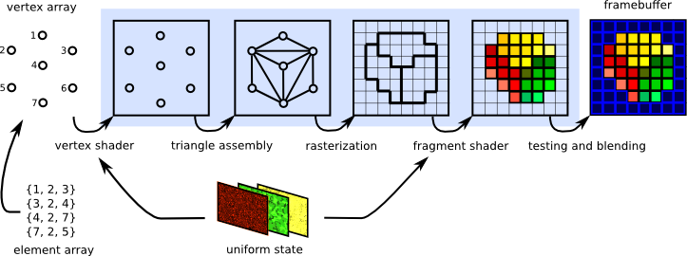
GPU Pipeline
sequence of steps used to create a 2D raster representation of a 3D scene.

Slide 6
OpenGL – fixed pipeline
Early days of opengl and graphics
Build in functions
Hard-coded lighting, transformation etc...
Removed from OpenGL 3.2

Slide 7
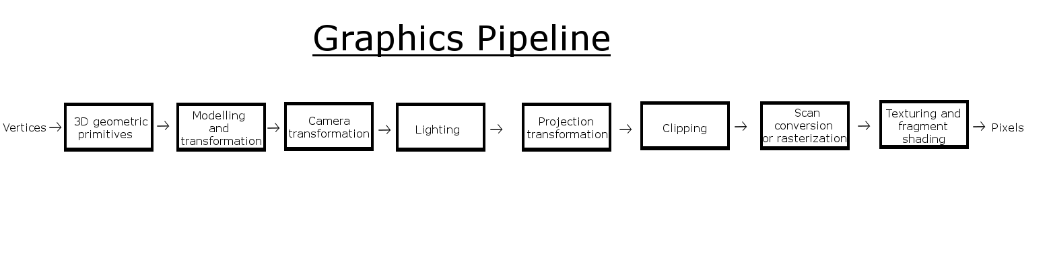
Fixed pipeline

Slide 8
OpenGL – programmable pipeline
Introduces shaders ( programs that run on GPU )
Vertex shader - deals with vertex, color, texture coordinates
Fragment Shader or Pixel Shader - deals with individual pixels
Geometry Shader – deals with assembeled primitives

Slide 9
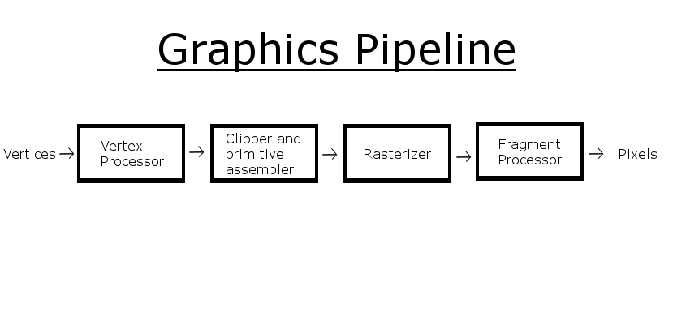
Programmable pipeline

Slide 10
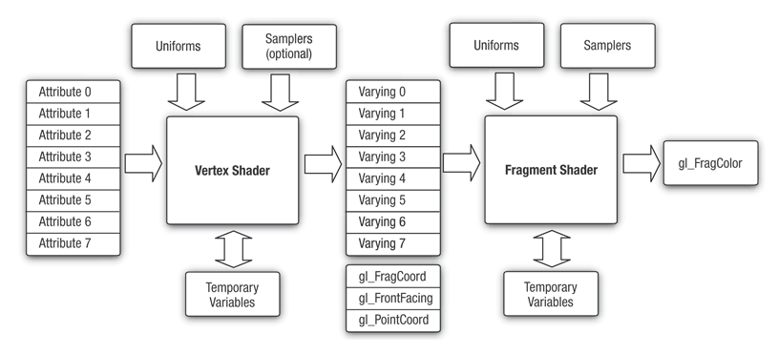

Slide 11
Open GL glossary
Frame – frame of animation
Program – object to which shaders can be attached
Shader – program that runs in GPU pipeline
Buffer - region of a physical memory storage used to temporarily store data
Framebuffer - type of data buffer for use in graphical display

Slide 12
Open GL – variable qualifiers
const – The declaration is of a compile time constant.
attribute – Global variables that may change per vertex, that are passed from the OpenGL application to vertex shaders. This qualifier can only be used in vertex shaders. For the shader this is a read-only variable

Slide 13
Open GL – variable qualifiers
uniform – Global variables that may change per primitive [...], that are passed from the OpenGL application to the shaders. This qualifier can be used in both vertex and fragment shaders. For the shaders this is a read-only variable
varying – used for interpolated data between a vertex shader and a fragment shader. Available for writing in the vertex shader, and read-only in a fragment shader. ( in and out keywords , varying in WebGL ).

Slide 14
https://github.com/luka712/mscommunity_os_opentk.git

Slide 15
Hvala

Slide 16


